Slide 1
KNN
K-Nearest Neighbour Classifier

Slide 2
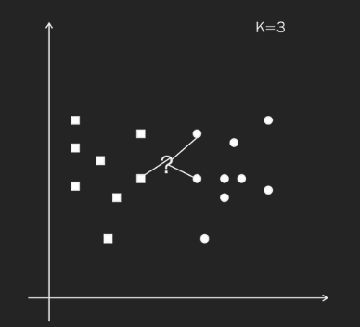

K-Nearest neighbout

Slide 3
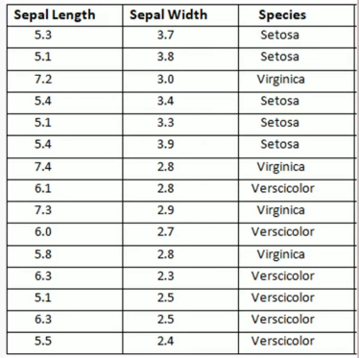
KNN

Slide 4
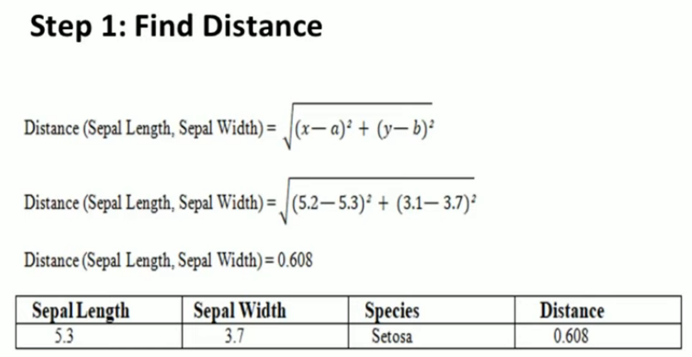
FIRST DATA
TEST DATA

Slide 5

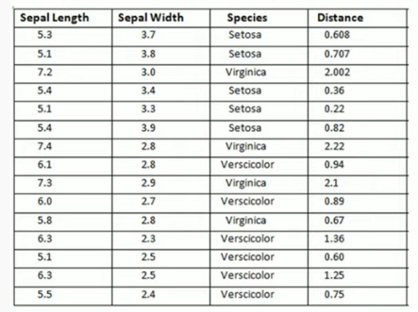
Notes:
Data Preprocessing and Association Rules

Slide 6

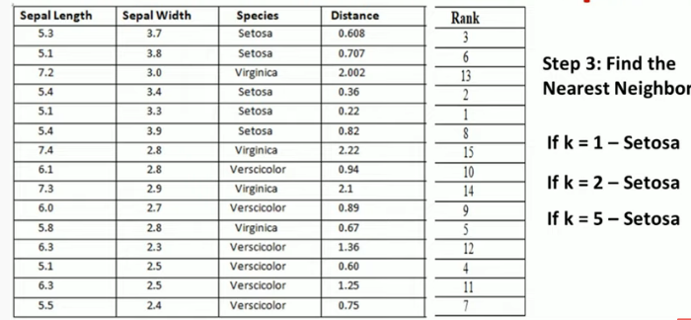

Slide 7
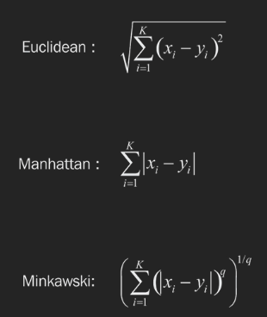
Distance Measures

